Slide 1
CONTEXT DIAGRAM AND OTHER DFD LEVELS

Slide 2
Group members:
Mavia Fatima F20232661019
Rbiya Ahmad F20232661035
Faiza Abrar F2023266433
Khuzaima Tajammal F2023266890

Slide 3
What is a context diagram?
Context Diagrams are high-level visual representations that show the interactions between a system being developed and its external entities, such as users, other systems, or processes.
Context diagrams serve as a foundational tool. They can figure out how best to design a new system and its requirements or how to improve an existing system.
They don’t go into the detailed ins and outs of the system. Instead, they map out an entire system in a way that’s simple, clear, and easy to understand.
For example, arrows are used to represent the flow of data between the system and each external element.

Slide 4
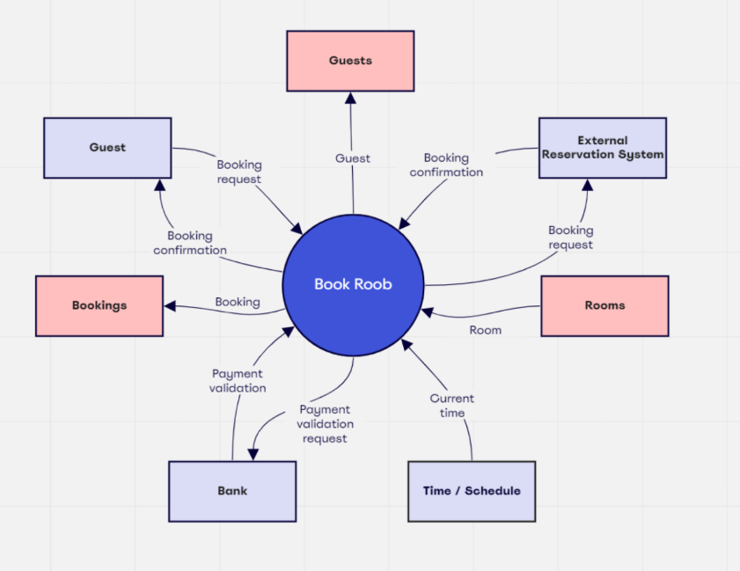
Example: Online hotel reservation system

Slide 5
Why context diagrams are useful?
Clarify system boundaries: A context diagram shows what is inside the system (i.e., what the software will do) and what is outside (i.e., external elements such as users, other systems, or hardware). This helps stakeholders clearly understand the limits of the system.
Illustrate interactions: It shows how the system interacts with external entities—such as who or what sends data to the system and who or what receives data from it.
Acts as a Bridge: This is also helpful when it comes to sharing this information with external parties. For example, if we need to get input and feedback from stakeholders outside the business. We don’t have to worry about explaining everything in detail because the diagram itself is self-explanatory.

Slide 6
Reduces risks: Context diagrams allow to plan how system interacts with external entities before going live. This gives the chance to identify potential issues before they happen and put preventative measures in place.
Enables collaboration: Having a context diagram in place makes it easier for the team to collaborate. We can share the diagram with anyone. From colleagues to management and even key project stakeholders, everyone can be involved in the process.
We can take everyone’s feedback into account and make the necessary changes to accommodate their perspectives.
https://miro.com/blog/context-diagram/
https://www.geeksforgeeks.org/context-diagrams/

Slide 7
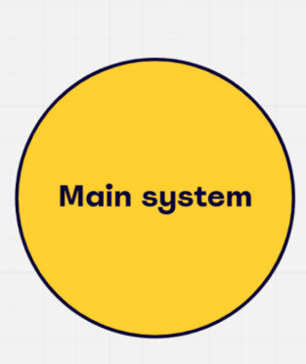
how to create a context diagram
1. Understand your system
Before you create the diagram, you need to fully understand what you want your system to be. Understanding how it currently works will help you identify areas of improvement throughout the rest of the process.
2. Add your system to the diagram
It depends on the structure you want to use. Most context diagrams will have the main system in the center circle, which is the focal point of the diagram. All the external elements interact with this circle.

Slide 8
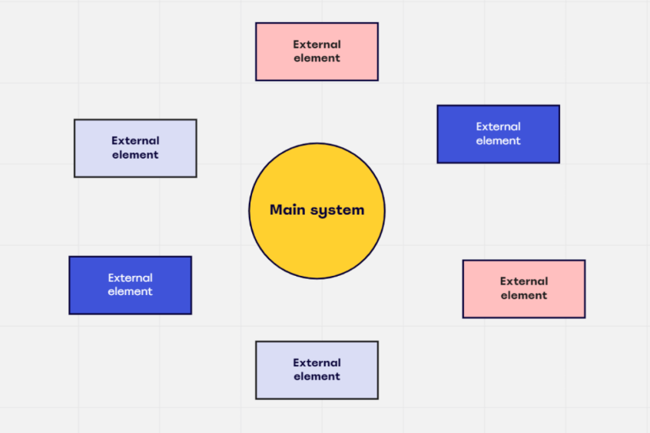
3. Add your external entities:
Using squares, rectangles, or any other shapes you want, you can list external entities that interact with the system.

Slide 9
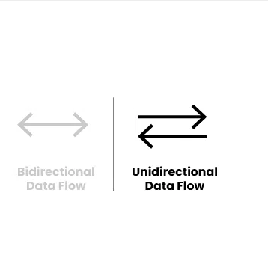
4. Use arrows to outline the data flow
With all the elements on the diagram, it’s time to add arrows to create the direction of the data flow. This will show how the external elements interact with the system.
You’ll also have labels alongside the arrows to show the relationship between the two entities.
Remember that data can flow both ways in the diagram. Using a double-ended arrow illustrates this.

Slide 10
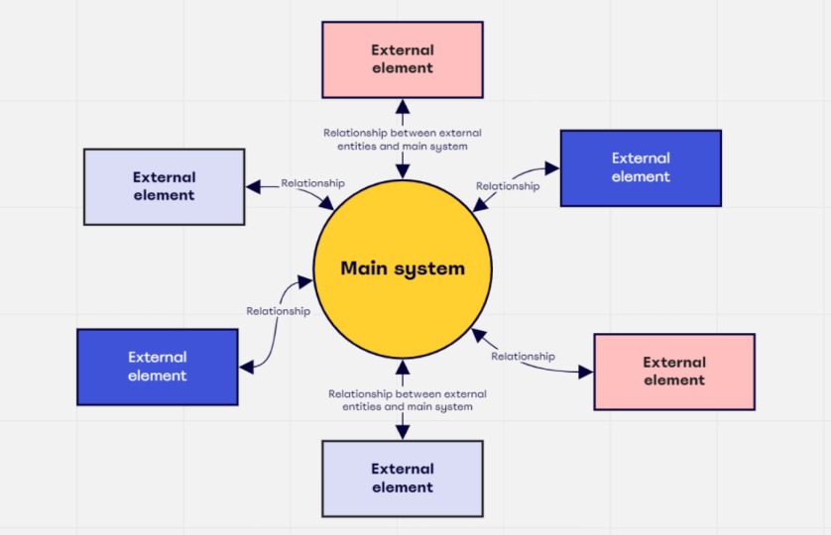
5. Share the finished diagram
When the diagram is done, it’s time to share it with the relevant parties to get feedback.
https://miro.com/blog/context-diagram/
https://www.geeksforgeeks.org/context-diagrams/

Slide 11
What are DFD Levels
DFD is the abbreviation for Data Flow Diagram. The flow of data in a system or process is represented by a Data Flow Diagram (DFD). It also gives insight into the inputs and outputs of each entity and the process itself. Data Flow Diagram (DFD) does not have a control flow and no loops or decision rules are present. Specific operations, depending on the type of data, can be explained by a flowchart. It is a graphical tool, useful for communicating with users, managers and other personnel. it is useful for analyzing existing as well as proposed systems.
https://www.geeksforgeeks.org/what-is-dfddata-flow-diagram/

Slide 12
Components of dfd diagram
The Data Flow Diagram has 4 components:
Process: Input-to-output transformation in a system takes place because of process function. The symbols of a process are rectangular with rounded corners, oval, rectangle or a circle. The process is named a short sentence, in one word or a phrase to express its essence
Data Flow: Data flow describes the information transferring between different parts of the systems. The arrow symbol is the symbol of data flow. A relatable name should be given to the flow to determine the information which is being moved
Warehouse (Data Store) : The data is stored in the warehouse for later use. Two horizontal lines represent the symbol of the store. The warehouse is simply not restricted to being a data file rather it can be anything like a folder with documents, an optical disc, a filing cabinet.
(External Entity): The Terminator is an external entity that stands outside of the system and communicates with the system. It can be, for example, organizations like banks, groups of people like customers or different departments of the same organization, which is not a part of the model system and is an external entity.
https://www.geeksforgeeks.org/what-is-dfddata-flow-diagram/

Slide 13
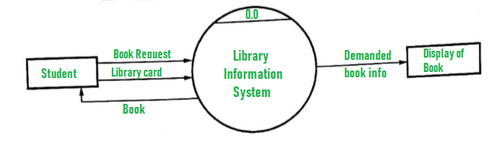
Level 0 DFD (Context Diagram)
Overview: It is also known as a context diagram. It’s designed to be an abstraction view, showing the system as a single process with its relationship to external entities. It represents the entire system as a single bubble with input and output data indicated by incoming/outgoing arrows.
Components:
Process: Represents the entire system as a single process.
External Entities: These are outside the system, such as users or other systems that send or receive data.
Data Flows: Arrows showing the flow of data between the external entities and the system.
https://www.geeksforgeeks.org/what-is-dfddata-flow-diagram/

Slide 14
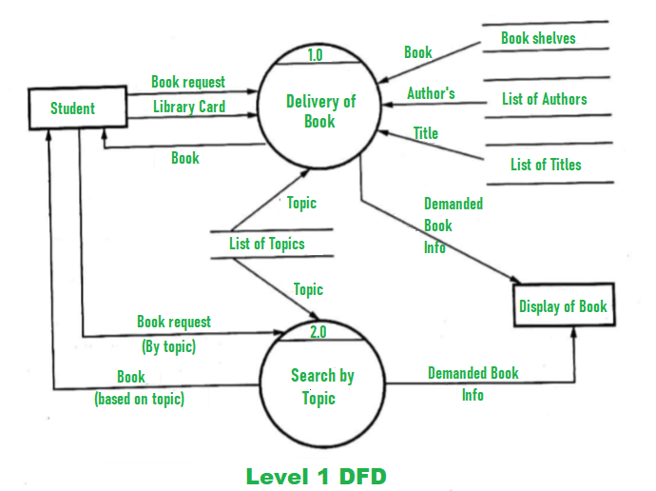
Level 1 DFD
Overview: This level breaks down the single process from Level 0 into major sub-processes. It provides a more detailed view of how the system operates.
Components:
Processes: Each major function of the system is represented as a separate process.
Data Stores: These are places where data is stored within the system.
Data Flows: Arrows showing how data moves between processes, data stores, and external entities.
https://www.geeksforgeeks.org/what-is-dfddata-flow-diagram/

Slide 15
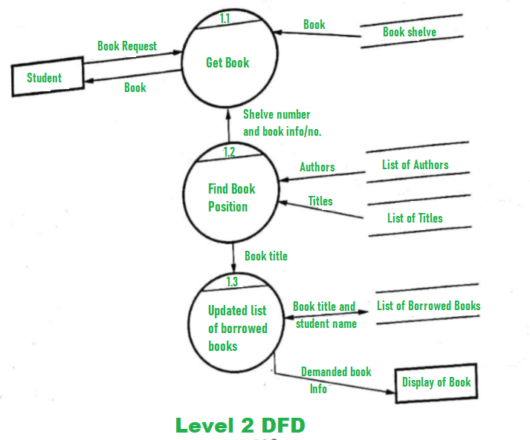
Level 2 DFD and Beyond
Overview: These levels provide even more detailed breakdowns of the processes shown in Level 1. Each sub-process can be further divided into its components.
Components:
Sub-Processes: Detailed representations of how each major process operates.
Additional Data Stores and Flows: More specific data storage and flow details relevant to the sub-processes.
https://www.geeksforgeeks.org/what-is-dfddata-flow-diagram/

Slide 16
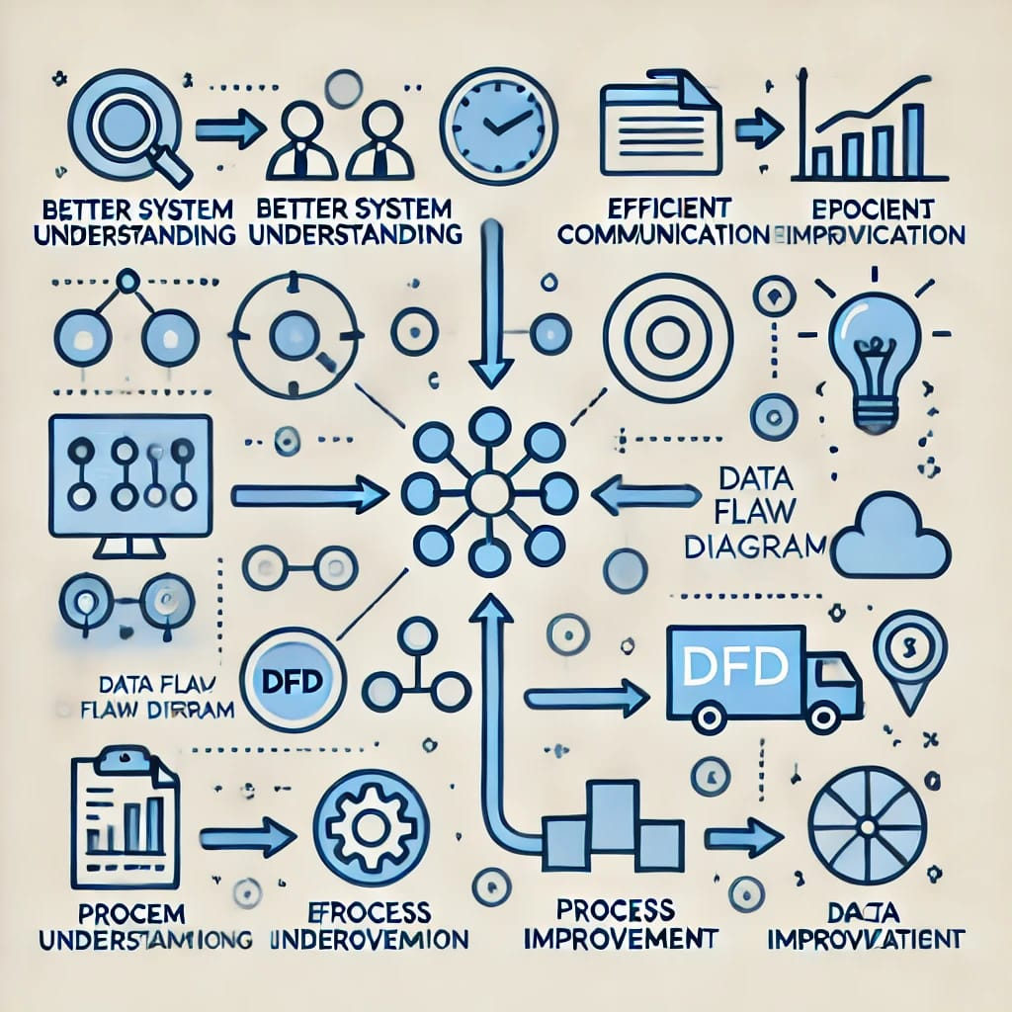
Benefits Of Using DFD
Data Flow Diagrams (DFDs) offer several benefits in system design and analysis:
1.Clarity and Simplification: DFDs decompose complex systems into manageable components, providing a clear, high-level overview that enhances understanding.
2.Facilitates Communication: They serve as a common language for both technical and non-technical stakeholders, ensuring clear communication among developers, analysts, and clients.

Slide 17
3.Highlights System Components: DFDs identify key processes, data stores, and external entities, illustrating dependencies and interactions within the system.
4.Supports Requirements Gathering: By visualizing how data is processed and transferred, DFDs assist in understanding system requirements, particularly during the early stages of development.
5.Problem Identification: They help pinpoint missing or redundant processes, unnecessary data transfers, or potential security risks, providing a foundation for troubleshooting and optimization.

Slide 18
6. Documentation and Maintenance: Serving as part of system documentation, DFDs aid in maintenance and future updates, offering a reference for system designers and developers to understand system functionality.
7.System Standardization: DFDs help standardize the design and development of systems by offering a consistent way to represent processes and data flows.
8.Scalability and Modularity: They can represent systems at different levels of detail, enabling scalability and allowing designers to focus on specific parts of the system without losing sight of the overall structure.
HubSpot Blog
GeeksforGeeks

